Slide 1
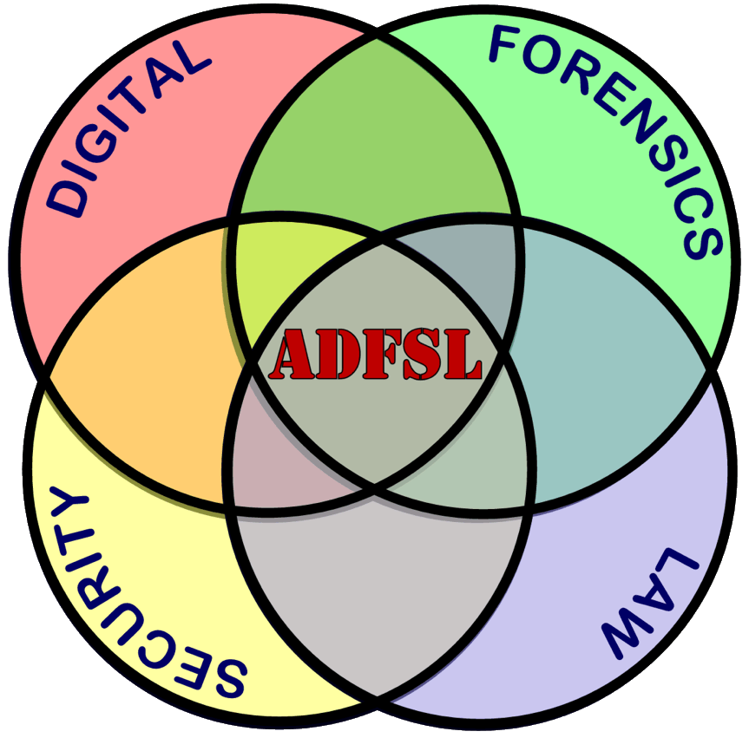
Microsoft Defender Will Be Defended - MemoryRanger Prevents Blinding Windows AV
Denis Pogonin
Igor Korkin
2022

Slide 2


WHO WE ARE
Denis Pogonin
Bachelor of Information Security
National Research Nuclear University MEPhI
Cryptology and Cybersecurity Department
Igor Korkin, PhD
Independent Security Researcher
Speaker at CDFSL, BlackHat, HITB, SADFE
sites.google.com/site/igorkorkin

Slide 3
Agenda
Bypassing AV products is a notorious malware trend
Microsoft Defender is the key target of cyber criminals
Kernel-mode threats are still the most risky
Microsoft Defender Internals: Signature Detection
Windows OS Internals: Mandatory Integrity Control
New kernel attack disables Microsoft Defender
MemoryRanger defends Microsoft Defender

Slide 10


Slide 15
Microsoft Defender is under attacks

Slide 16
Microsoft Defender is under attacks

Slide 17
Driver-based attacks can disable Microsoft Defender

Slide 18

Microsoft Defender is UNDER ATTACKs

Slide 19
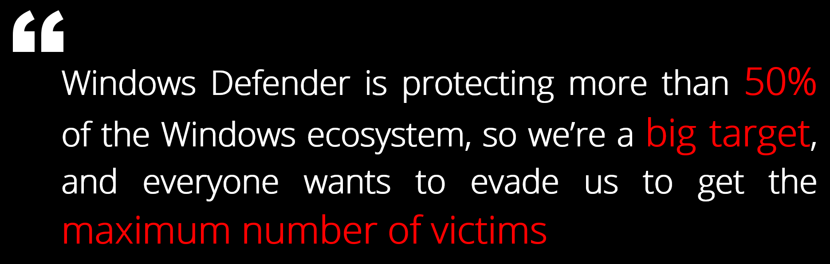

Microsoft Defender is running on over 500 000 000 PCs
Microsoft Defender is protecting more than 50% of the Windows ecosystem, so we’re a big target, and everyone wants to evade us to get the maximum number of victims
Tanmay Ganacharya
Partner Director for Security Research
@ Microsoft Defender for Endpoint
* Top Microsoft Defender expert: These are the threats security hasn't yet solved, ZDNet, 2019
https://www.zdnet.com/article/top-windows-defender-expert-these-are-the-threats-security-hasnt-yet-solved

Slide 20

Attack Vectors on Microsoft Defender

Slide 24
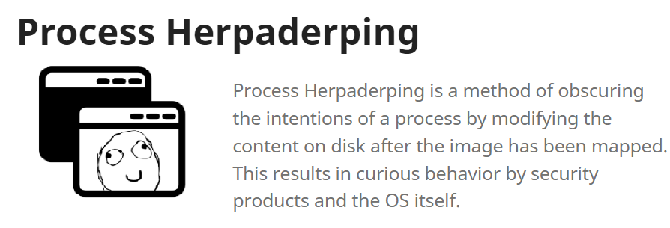

Slide 26


Slide 28

2022-02-02

Slide 30


Slide 31


Slide 32


Slide 34
All the details of these attacks are in the research paper

Slide 36

Microsoft Defender: INTRO

Slide 37
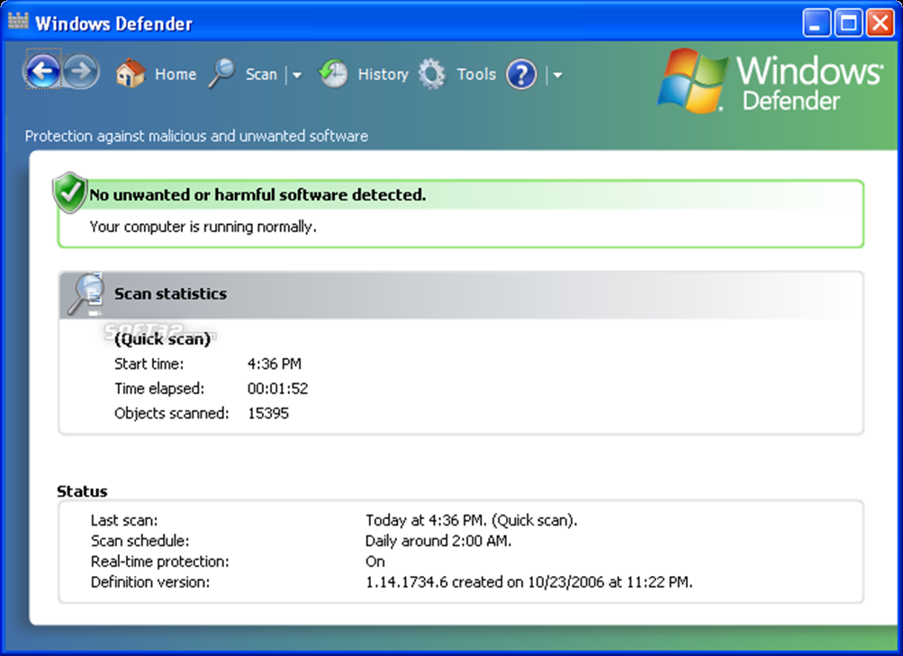
Microsoft Defender: Intro
2005 – the first release as a free anti-spyware program

Slide 38
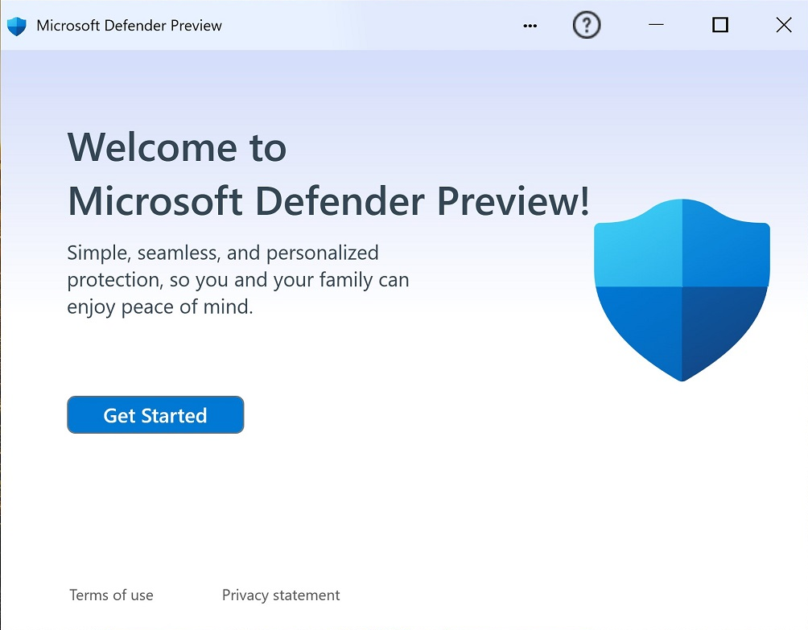
Microsoft Defender: Intro
2005 – the first release as a free anti-spyware program
2019 – Gartner: Microsoft Defender is the Leader in the Endpoint Protection Platforms (EPP) Magic Quadrant.

Slide 39

Microsoft Defender: components

Slide 40
Microsoft Defender: about 10 apps + 6 drivers
User-mode Processes and Services
MsMpEng
WinDefend
MsSense
NisSrv.exe
WdNisSvc
MsMpEngCP
MpCopyAccelerator
SecurityHealthService
WSCSVC
MPSSVC
Kernel-mode Drivers
WdFilter (file-filter)
WdDevFlt (device-filter)
MpsDrv (firewall)
WdBoot (ELAM)
WdNisDrv (NDIS WFP)
MpKSLDrv (update)

Slide 41
Microsoft Defender: about 10 apps + 6 drivers
User-mode Processes and Services
MsMpEng
WinDefend
MsSense
NisSrv.exe
WdNisSvc
MsMpEngCP
MpCopyAccelerator
SecurityHealthService
WSCSVC
MPSSVC
Kernel-mode Drivers
WdFilter (file-filter)
WdDevFlt (device-filter)
MpsDrv (firewall)
WdBoot (ELAM)
WdNisDrv (NDIS WFP)
MpKSLDrv (update)
• %ProgramData%\Microsoft\Microsoft Defender\Platform
• %Windir%\System32\drivers\wd

Slide 42
Microsoft Defender: about 10 apps + 6 drivers
User-mode Processes and Services
MsMpEng
WinDefend
MsSense
NisSrv.exe
WdNisSvc
MsMpEngCP
MpCopyAccelerator
SecurityHealthService
WSCSVC
MPSSVC
Kernel-mode Drivers
WdFilter (file-filter)
WdDevFlt (device-filter)
MpsDrv (firewall)
WdBoot (ELAM)
WdNisDrv (NDIS WFP)
MpKSLDrv (update)
• %ProgramData%\Microsoft\Microsoft Defender\Platform
• %Windir%\System32\drivers\wd

Slide 43
Microsoft Defender: Internals
MsMpEng.exe
User-mode
Kernel-mode

Slide 44
Microsoft Defender: Internals
MsMpEng.exe
User-mode
Kernel-mode
Inspects the newly created files to remove malicious
WdFilter
(file-filter)
Files on the disk

Slide 45
Microsoft Defender: Internals
MsMpEng.exe
Inspects the newly created processes to block malicious
Newly created processes
Newly created process
User-mode
Kernel-mode
Inspects the newly created files to remove malicious
WdFilter
(file-filter)
Files on the disk

Slide 46

Microsoft Defender: Internals
MsMpEng.exe
Inspects the newly created processes to block malicious
Newly created processes
MpEngine.dll
Newly created process
The core of AV detection includes 45,000+ functions
User-mode
Kernel-mode
Inspects the newly created files to remove malicious
WdFilter
(file-filter)
Files on the disk

Slide 47



Microsoft Defender: Internals
MsMpEng.exe
Newly created processes
Newly created process
WdFilter
(file-filter)
Files on the disk

Slide 48
Mandatory Integrity Control: Intro

Slide 49
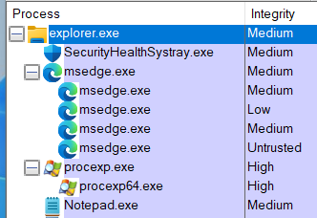
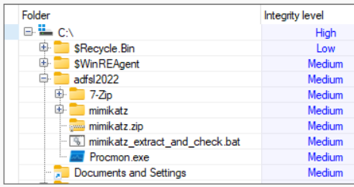
MIC: Integrity Levels of files and folders
* MicEnum – www.elevenpaths.com/innovation-labs/technologies/micenum

Slide 50
Defender TRIES TO open a file

Slide 51
Defender TRIES TO open a file

Slide 52
Defender FAILS TO open a file

Slide 53

Summary of MIC patching
Patching MIC isolates Windows Defender from filesystem. Windows Defender cannot remove malware files from the disk
Patching MIC is not enough to prevent Windows Defender from reading process memory. Windows Defender can still detect malware in memory.
Launching malware app fails with status STATUS_VIRUS_INFECTED (0xC0000906) that is returned by AV to block running malware app
Which driver returns this status?

Slide 54
Microsoft Defender: Internals
MsMpEng.exe
Inspects the newly created processes to block malicious
Newly created processes
MpEngine.dll
Newly created process
WdFilter
(file-filter)
Inspects the newly created files to remove malicious
Files on the disk

Slide 55

How can Microsoft Defender get access to apps memory?

Slide 56
Defender opens a process

Slide 57
Defender opens a process

Slide 58
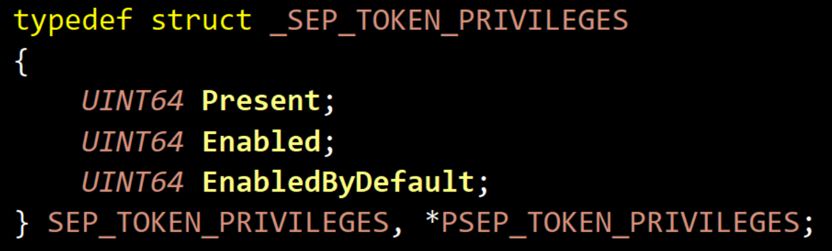
TOKEN Privileges
Research results:
revoking “SeDebugPrivilege” from “Enabled”
is enough to prevent Defender from inspecting the apps memory.

Slide 59

Attack on MIC and Token Privilege can disable Microsoft Defender without terminating its apps

Slide 60
Attack on MIC + Token Privilege: SCHEME
60

Slide 61
Attack on MIC + Token Privilege: SCHEME
61

Slide 62
Attack on MIC + Token Privilege: SCHEME
62

Slide 63
Attack on MIC + Token Privilege: SCHEME
63

Slide 64
Attack on MIC + Token Privilege: SCHEME
64

Slide 65
Attack on MIC: SCHEME

Slide 67
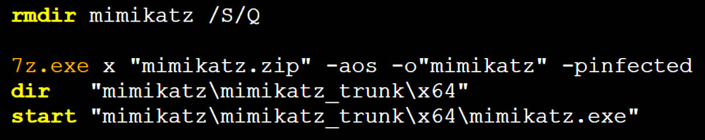
clear_extract_and_check.bat:

Slide 68
Attack on MIC + Token Privilege: DEMO
The online version is here – https://www.youtube.com/embed/ihhUUd9qJTY?vq=hd1440

Slide 69
Sandboxed Microsoft Defender fails to stop malware

Slide 70
Sandboxed Microsoft Defender fails to stop malware

Slide 71

MemoryRanger Defends Microsoft Defender

Slide 72
MemoryRanger: Intro

Slide 73
MemoryRanger: Intro

Slide 74
MemoryRanger: Intro

Slide 75
MemoryRanger: Intro

Slide 76
MemoryRanger: Intro

Slide 77
MemoryRanger: Intro

Slide 78
MemoryRanger: Features
Components:
user-mode control app
kernel-mode driver to register OS callbacks
hypervisor based dispatcher based on Intel VT-x and EPT technologies
The key features:
Runs kernel-mode drivers into isolated memory enclaves
Allows different memory access configuration for each memory enclave
Number of enclaves can be increased in runtime (while VBS has fixed 2 enclaves)
Technical features:
Hooks kernel API routines
Redirects illegal access to the sensitive data to the fake content
Supports newest Windows 11 x64 and it is open-source
github.com/IgorKorkin/MemoryRanger

Slide 79








MemoryRanger was in US, UK, and Asia and twice at BlackHat
2018
2019
2020
2021
2022

Slide 80
MemoryRanger Customization protects Microsoft Defender

Slide 81
MemoryRanger Customization protects Microsoft Defender

Slide 82
MemoryRanger Defends Microsoft Defender: Demo
The online version is here – https://www.youtube.com/embed/Ohqhq50wVjI?vq=hd1440

Slide 83
Conclusion
Kernel-mode threats are very dangerous even for Windows 11 x64
The global malware trend is to bypass or disable AV/EDR products without terminating the AV/EDR apps
Microsoft Defender is the most desired goal for attackers
Mandatory Integrity Control (MIC) is designed to sandbox untrusted apps, but attackers can abuse MIC to sandbox Microsoft Defender and other AVs.
MemoryRanger blocks attacks on kernel data including attacks on MIC

Slide 84

Thank you!
Denis Pogonin | denpog00@gmail.com
Igor Korkin | igor.korkin@gmail.com
All the details are here | igorkorkin.blogspot.com
Notes:
Thank you!

Slide 85

This attack can blind Microsoft Defender. What about other AVs?

Slide 86











MIC-based attack blinds top AV solutions
AV Name | AV ability to detect malicious files | AV ability to detect malicious processes
Microsoft Defender | Disabled | Disabled
McAfee | Disabled | Disabled
Malwarebytes | Disabled | Disabled
Avast | Disabled | Disabled
AVG | Disabled | Disabled
Kaspersky | Disabled | Enabled
 | Enabled, but AV cannot remove malware files | Disabled
Disclaimer: The purpose is to provide technical review only. This analysis is not designed to promote any solutions.
We do respect all antiviruses and endpoint security solutions.

